Slide 1
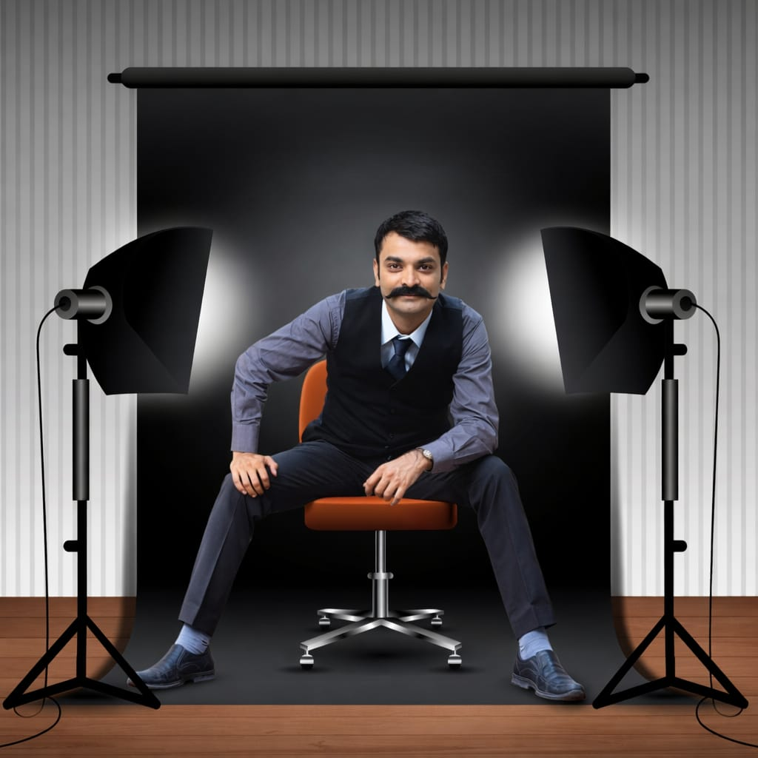

Naam HD Kaam HD
Himanshu N. Dubal
Founder
( Service Area Pan INDIA )
+91 95122 95773 – 9979157525.
Ranip, Ahmedabad.
www.hdstudio.co.in

Slide 2
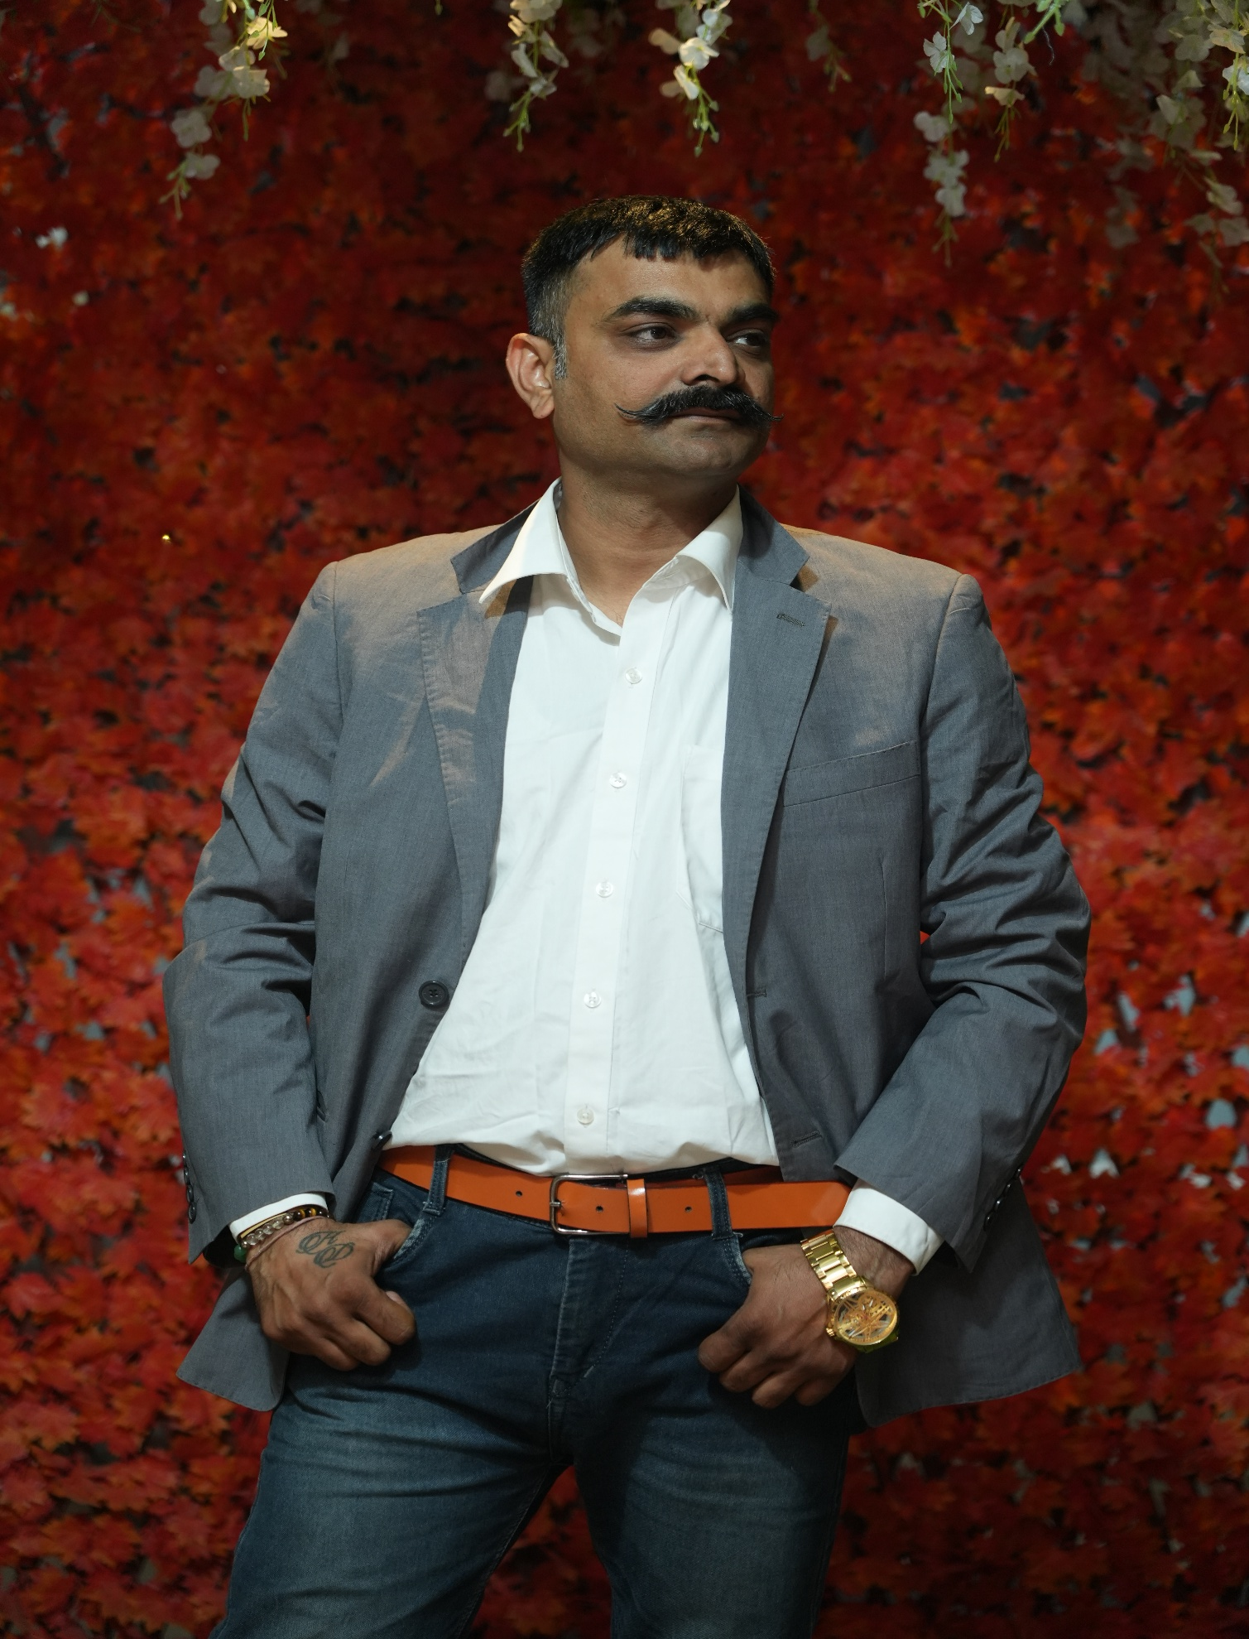
About Us
Established in 2012, our company brings over 14+ years of expertise in drone photography and aerial solutions. We are proud to hold a DGCA-certified drone license, ensuring our operations meet the highest standards of safety and compliance.
Led by a skilled and passionate drone photographer, we are committed to delivering top-quality drone services tailored to our clients' needs. Our core expertise spans drone surveying, aerial photography, autonomous flights, and land mapping.
With a vision to become the leading drone service provider in the industry, we focus on offering high-quality results at the most competitive prices—growing and evolving year after year.

Slide 3
Our Expertise
Land Mapping & Surveying
Industrial Photography & Videography
Wedding
Pre-Wedding
Corporate Events
Company Conference
Interviews
Concerts & Shows
Indoor – Outdoor
Interior & Architect Shoot

Slide 4

Drone Services
  Drone Surveying
  Land Mapping & Analysis
  Autonomous Drone Flights
  Aerial Photography & Videography
  Land Survey & Mapping
CERTIFIED
DRONE PILOT

Slide 5


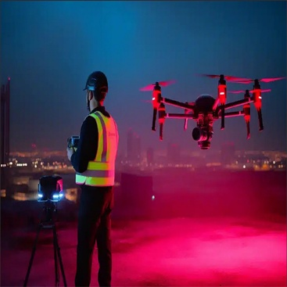
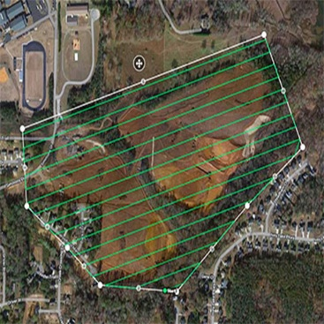

Slide 6
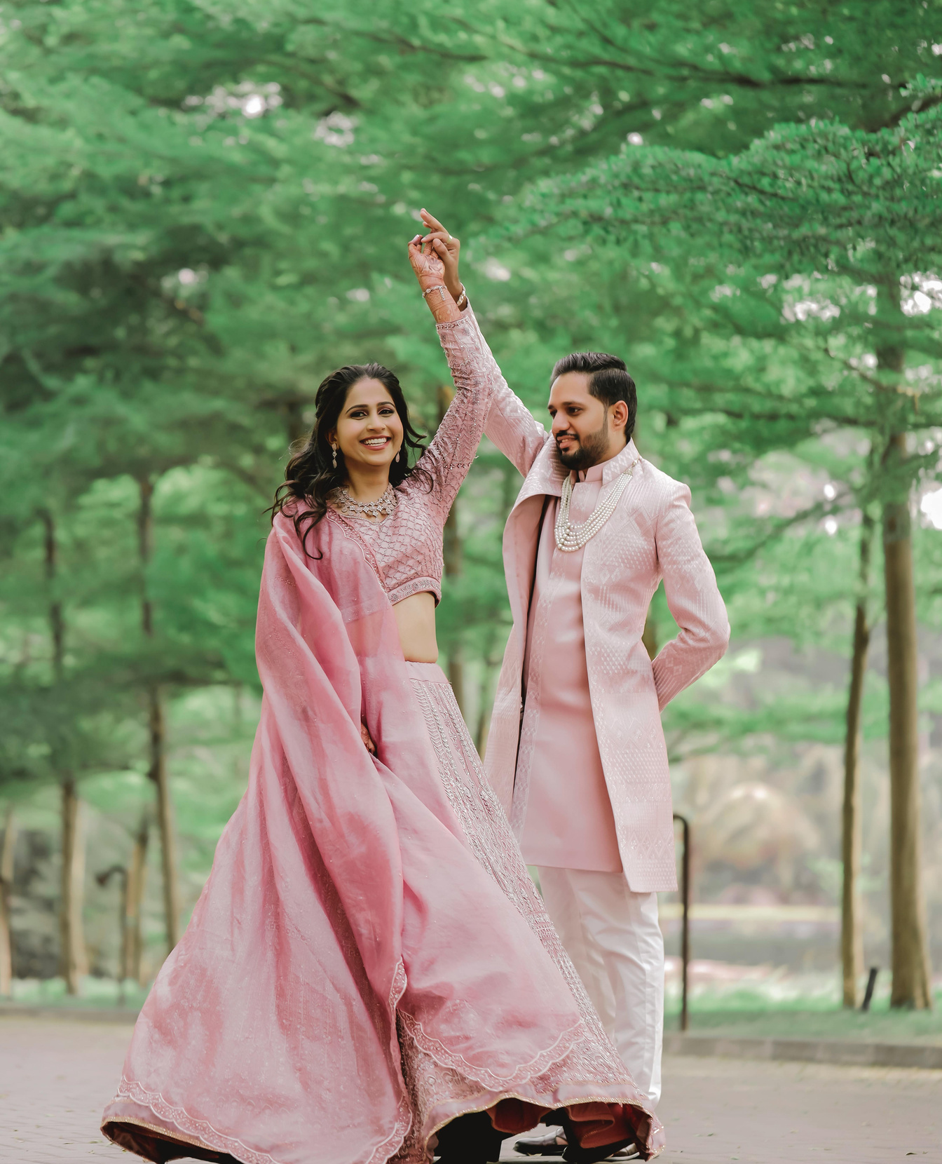
Wedding & Event Coverage
  Wedding Photography & Videography
  Pre-Wedding Shoots
  Concerts & Shows
  Company Conferences
  Corporate Events
  Indoor & Outdoor Photography
  Event Photography

Slide 7




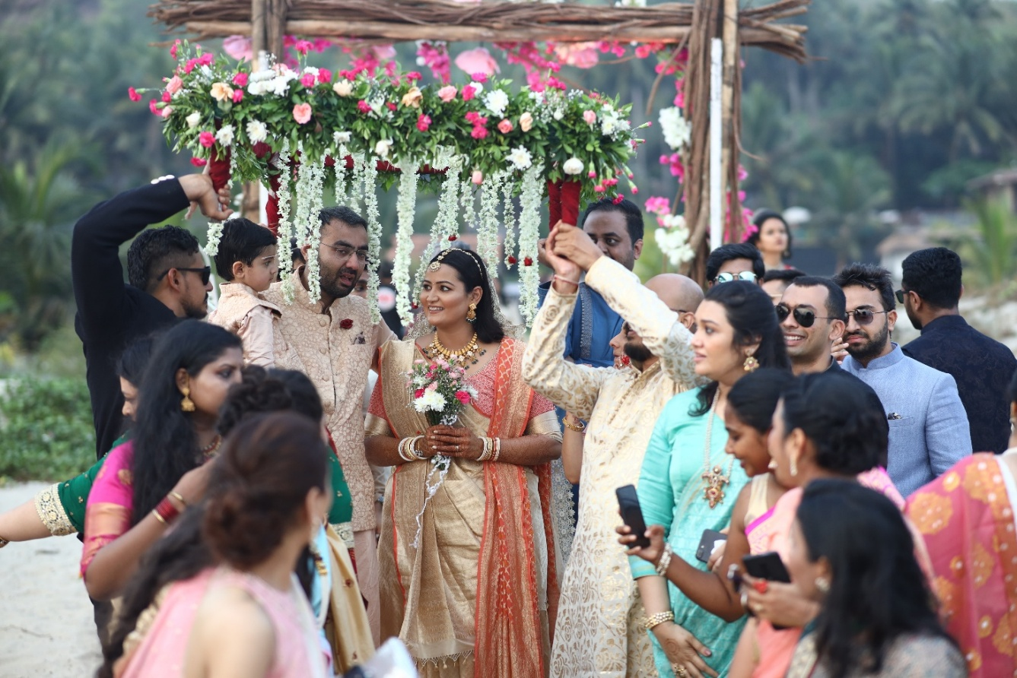


Slide 8

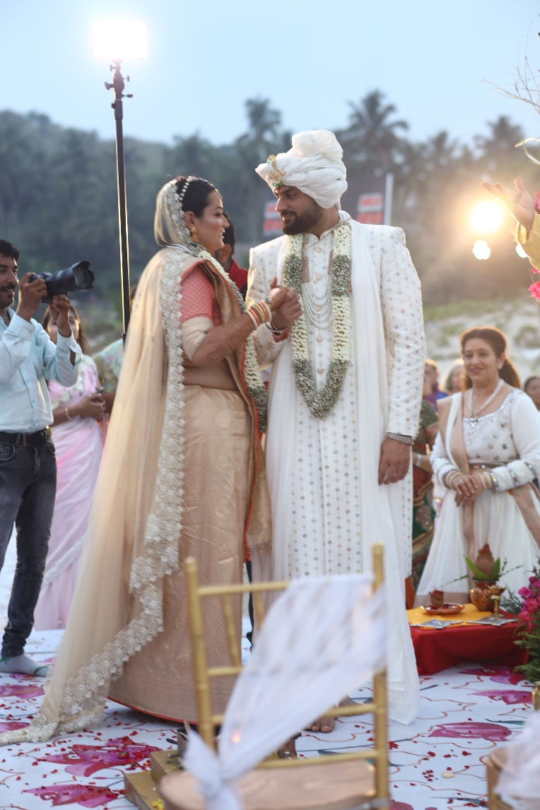
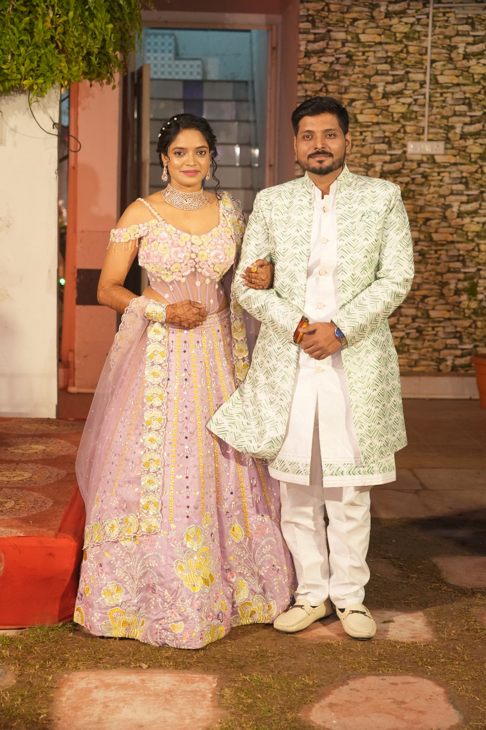


Slide 9

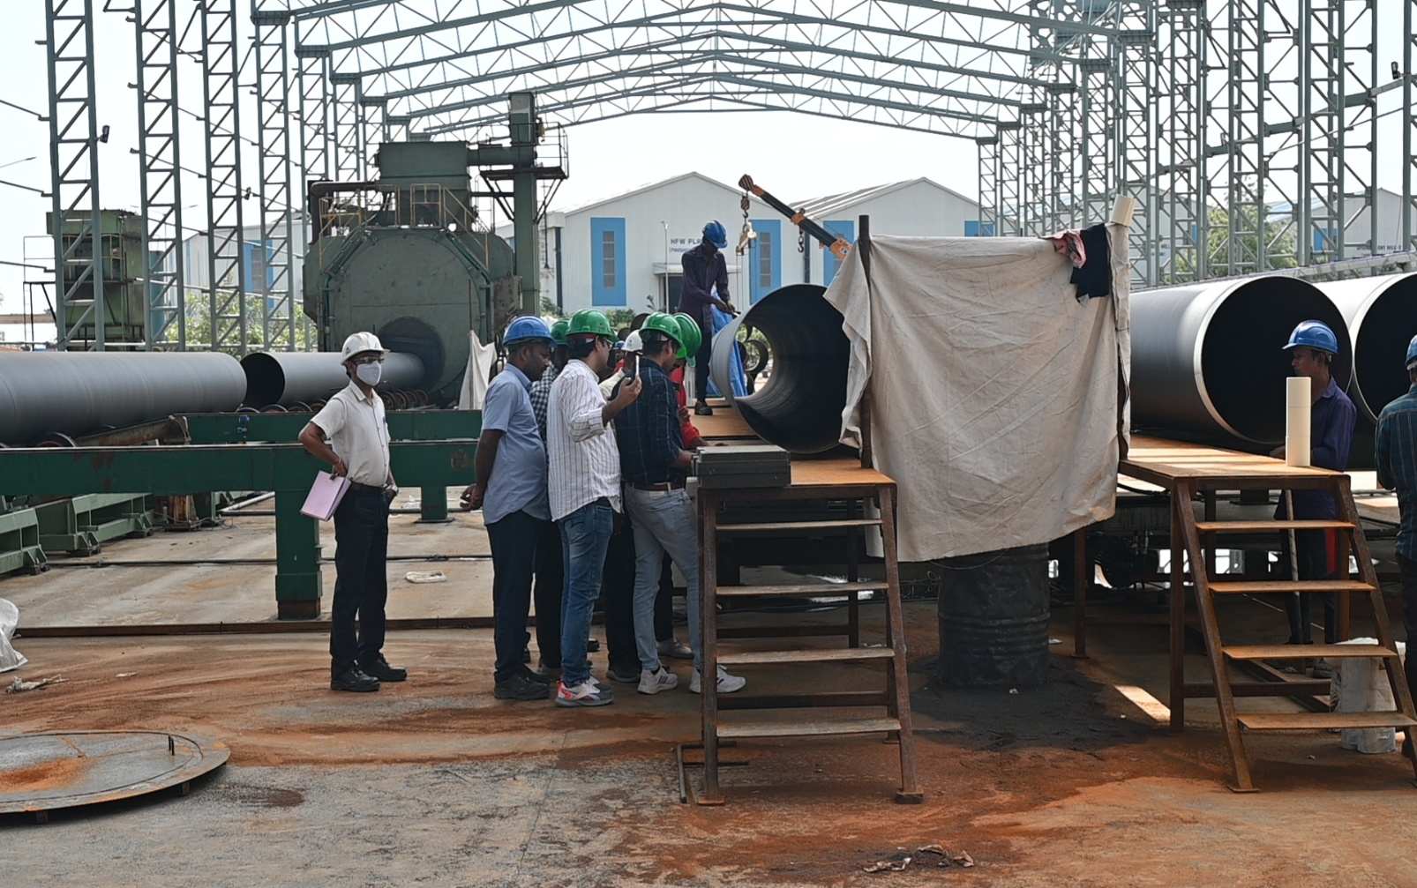
Commercial & Industrial Solutions
  Industrial Photography & Videography
  Interviews (Corporate/Media)
  Real Estate & Construction Projects
  Agricultural Survey & Mapping

Slide 10
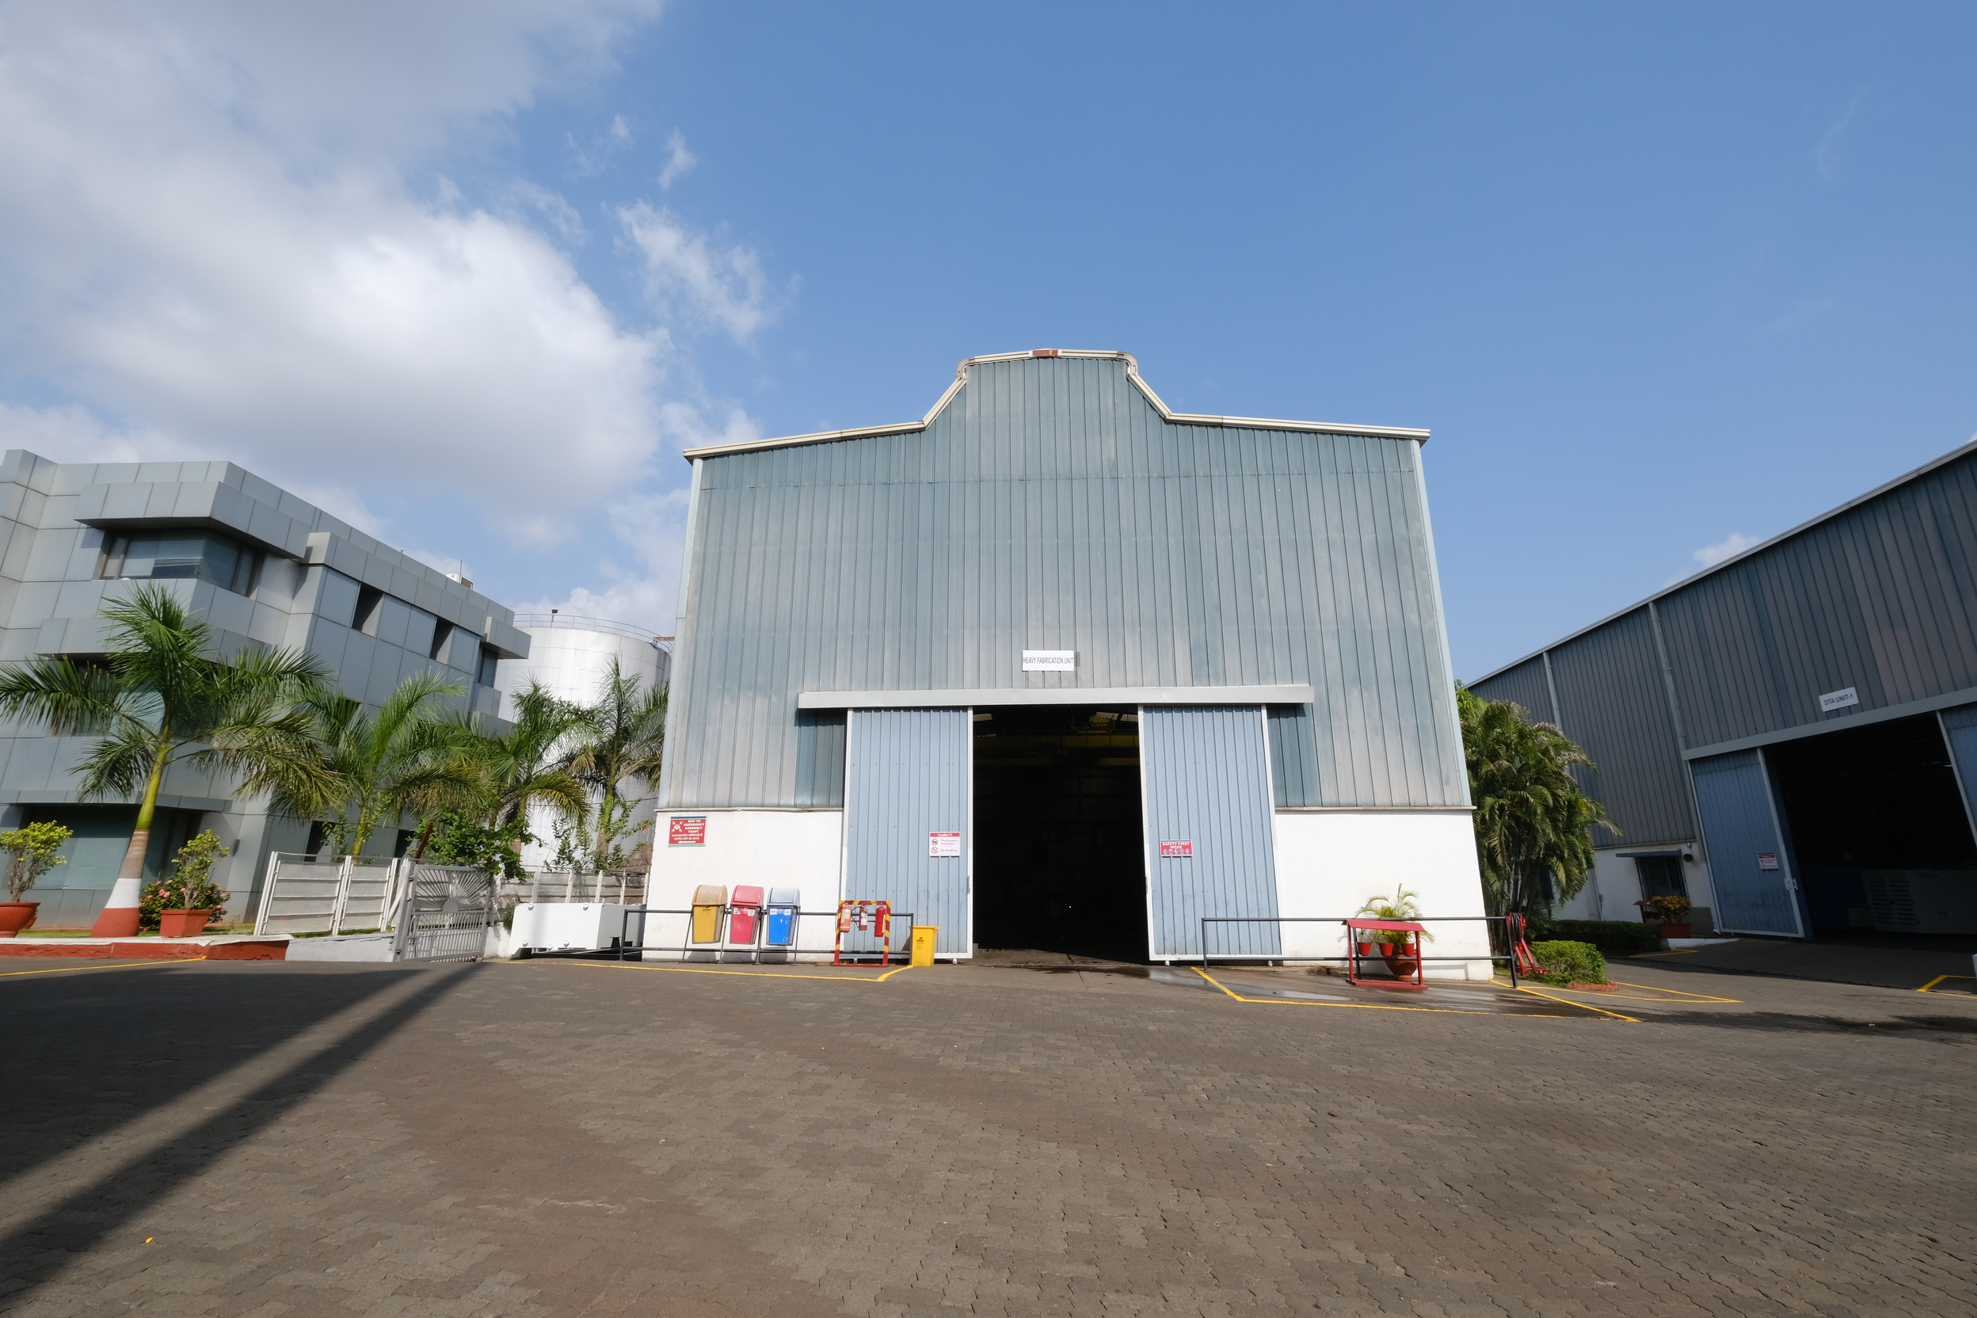
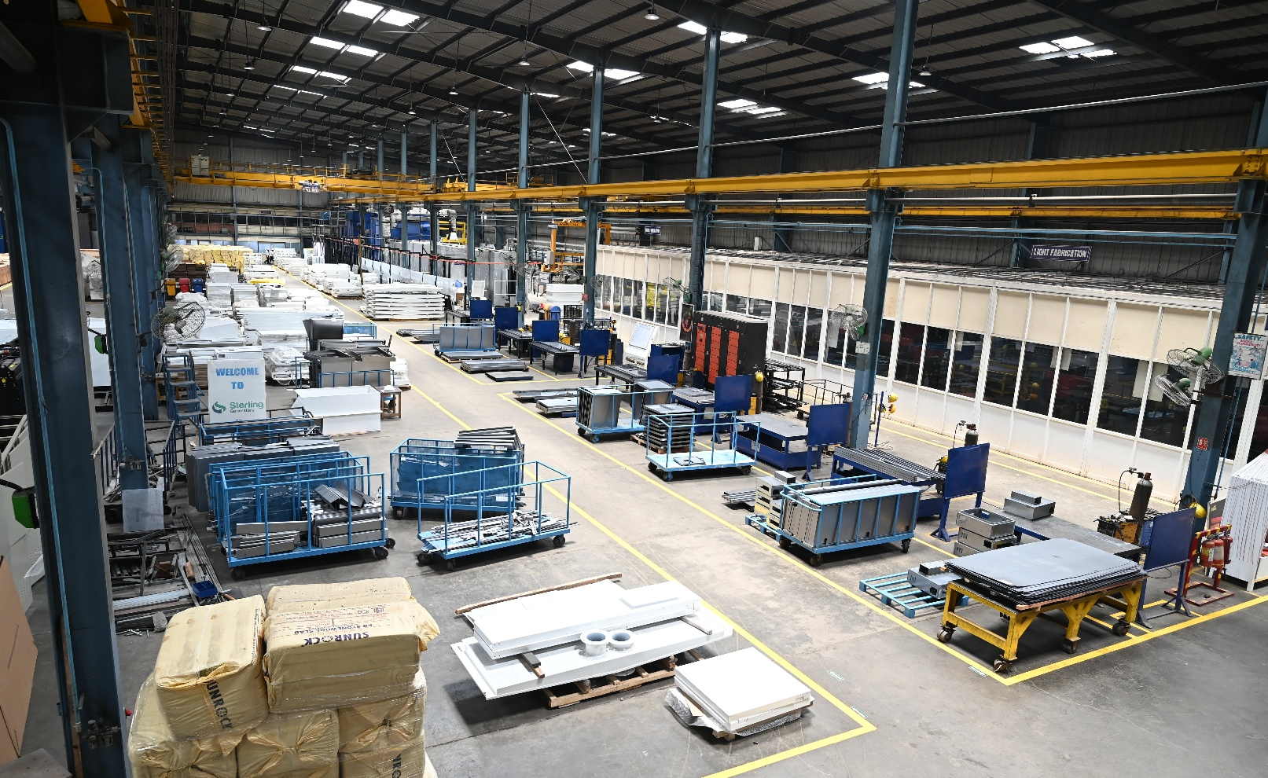
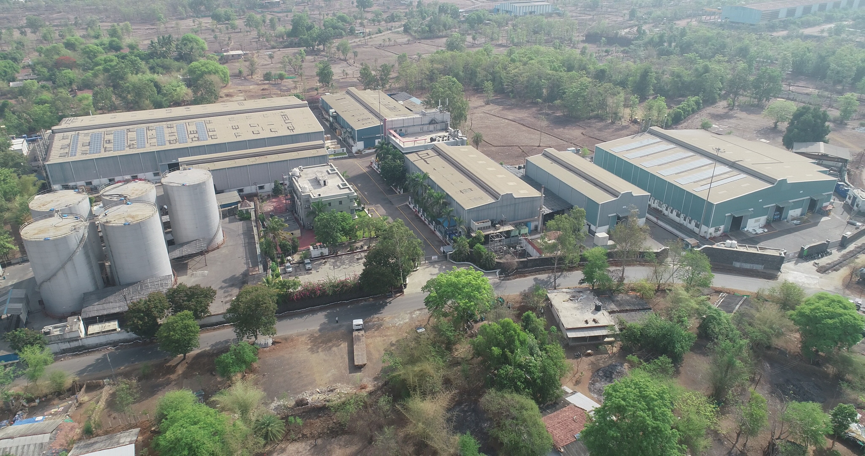
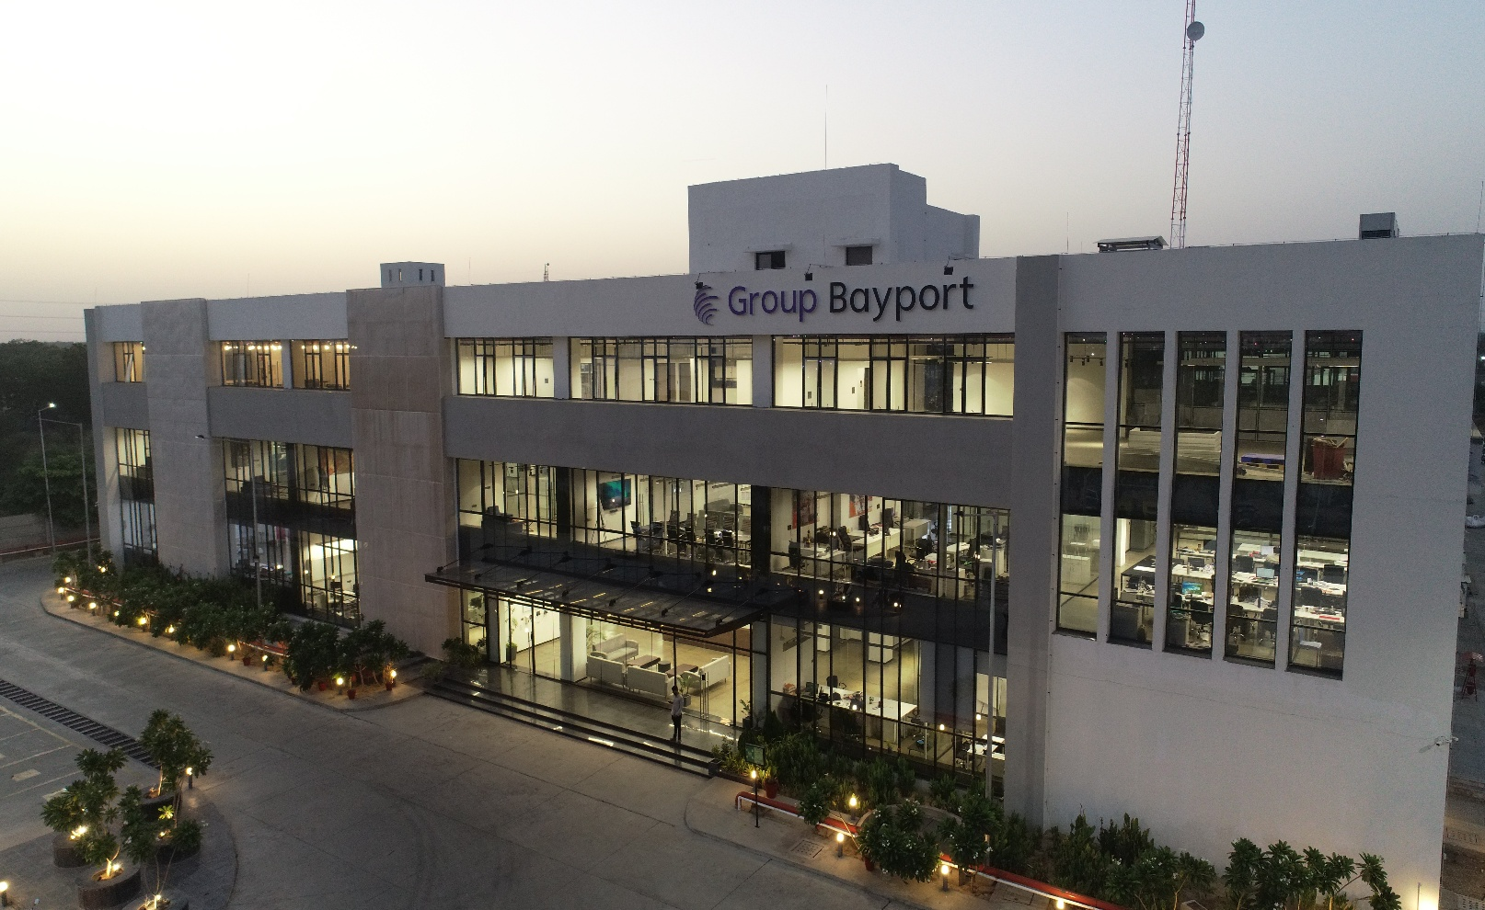

Slide 11
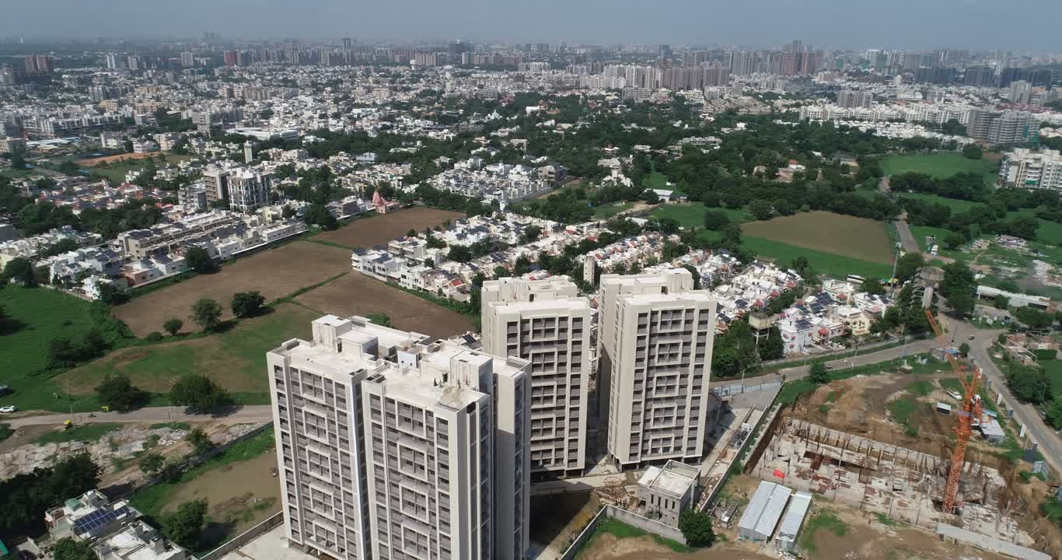

Slide 12
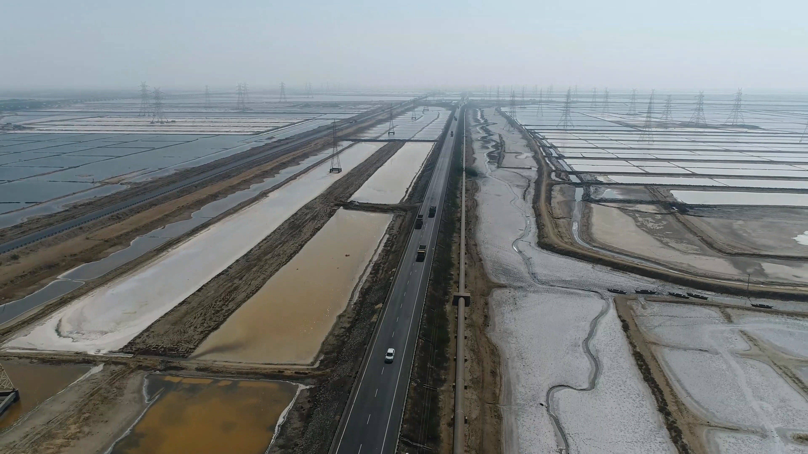

Slide 13
Why Choose Us?
Latest Equipment & Technology
14+ Years of Expertise
Cost-Effective, High-Quality Output
DGCA-Certified Drone Pilot
Dedicated Client Support & Timely Delivery

Slide 14
Our Work

Slide 15
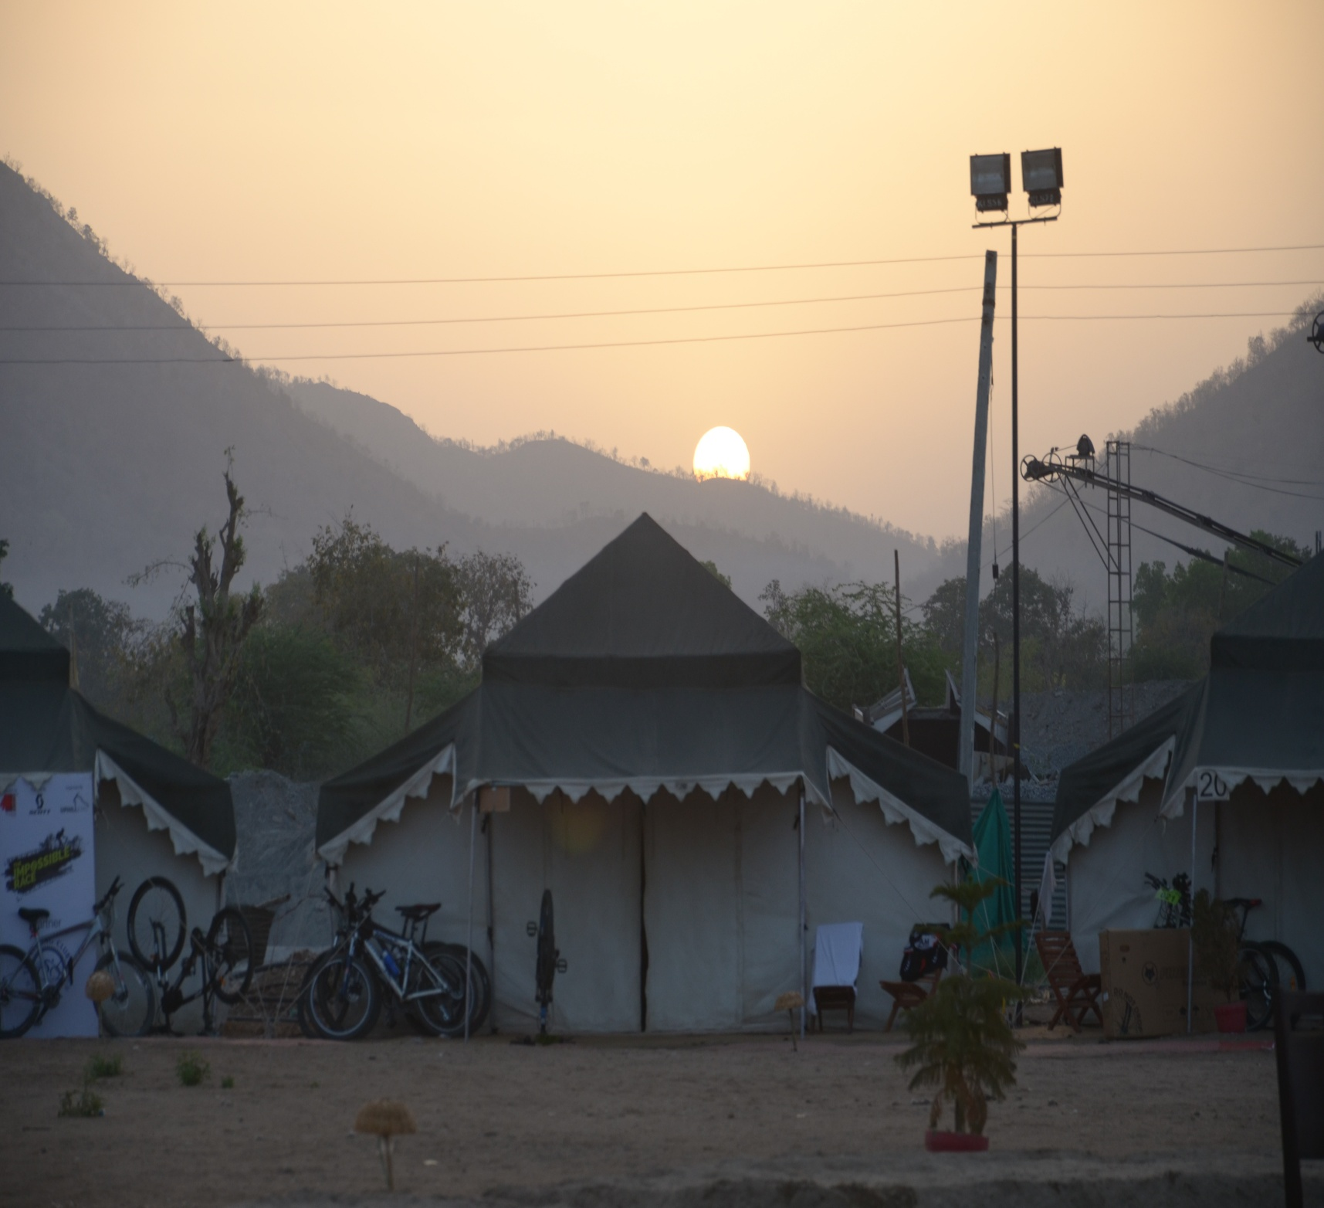
Corporate Events
  All Type’s of Corporate Events
  Videography
  Photoshoot
  Droneography

Slide 16
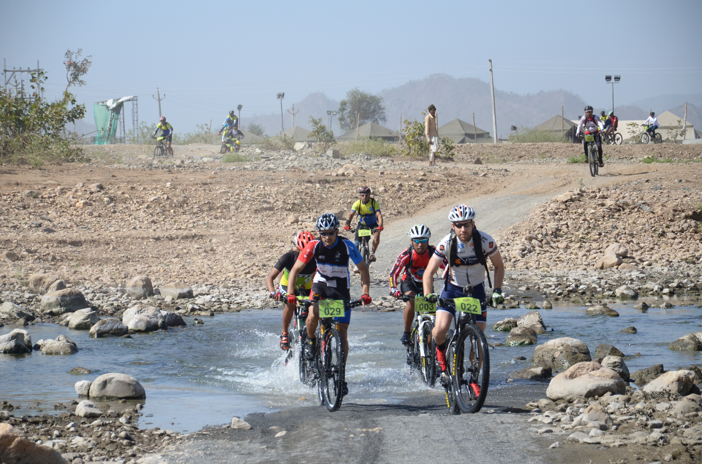
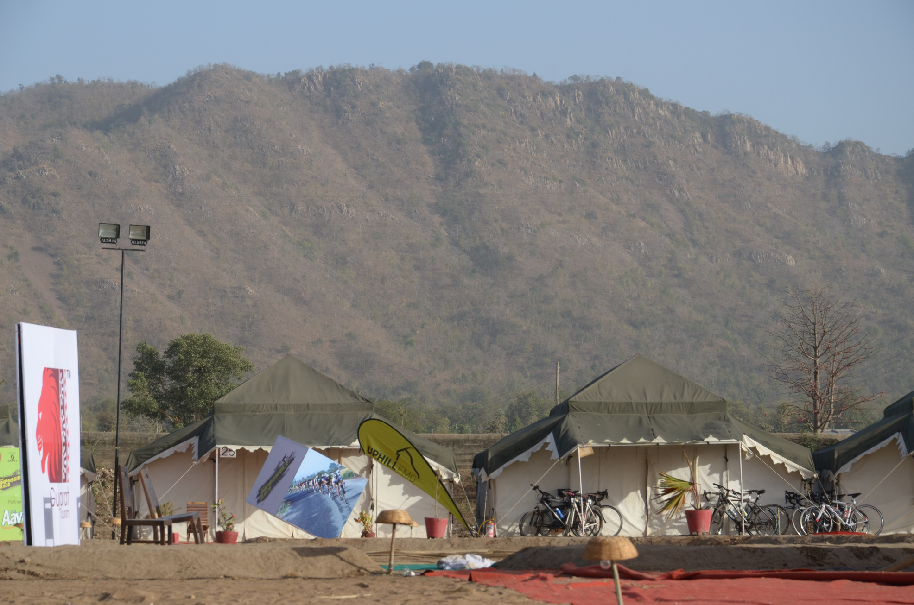



Slide 17
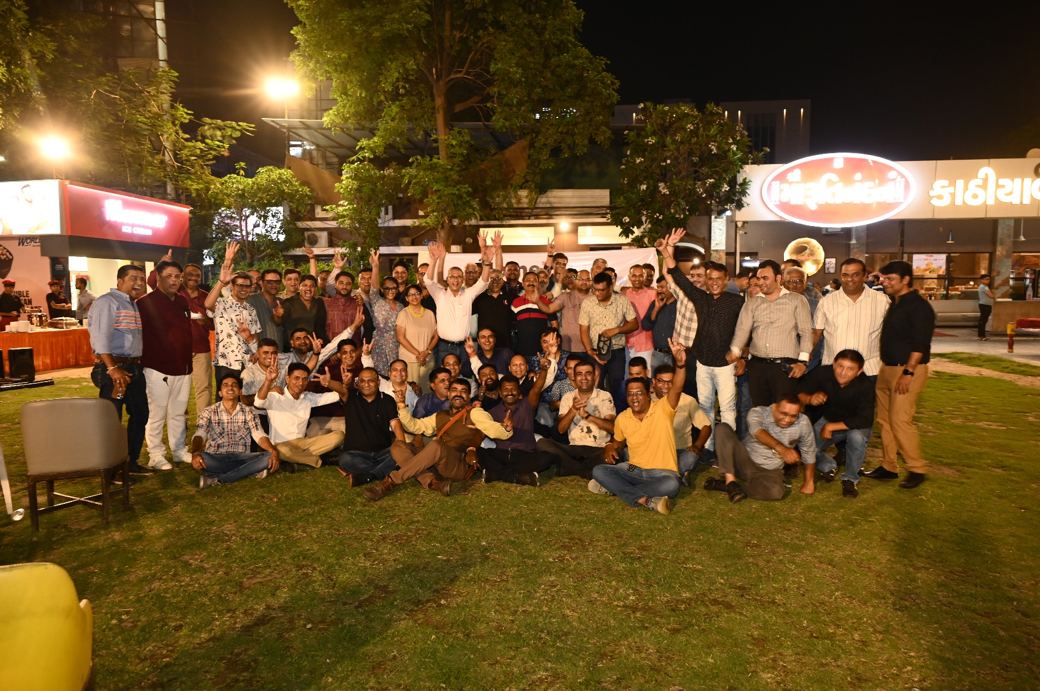
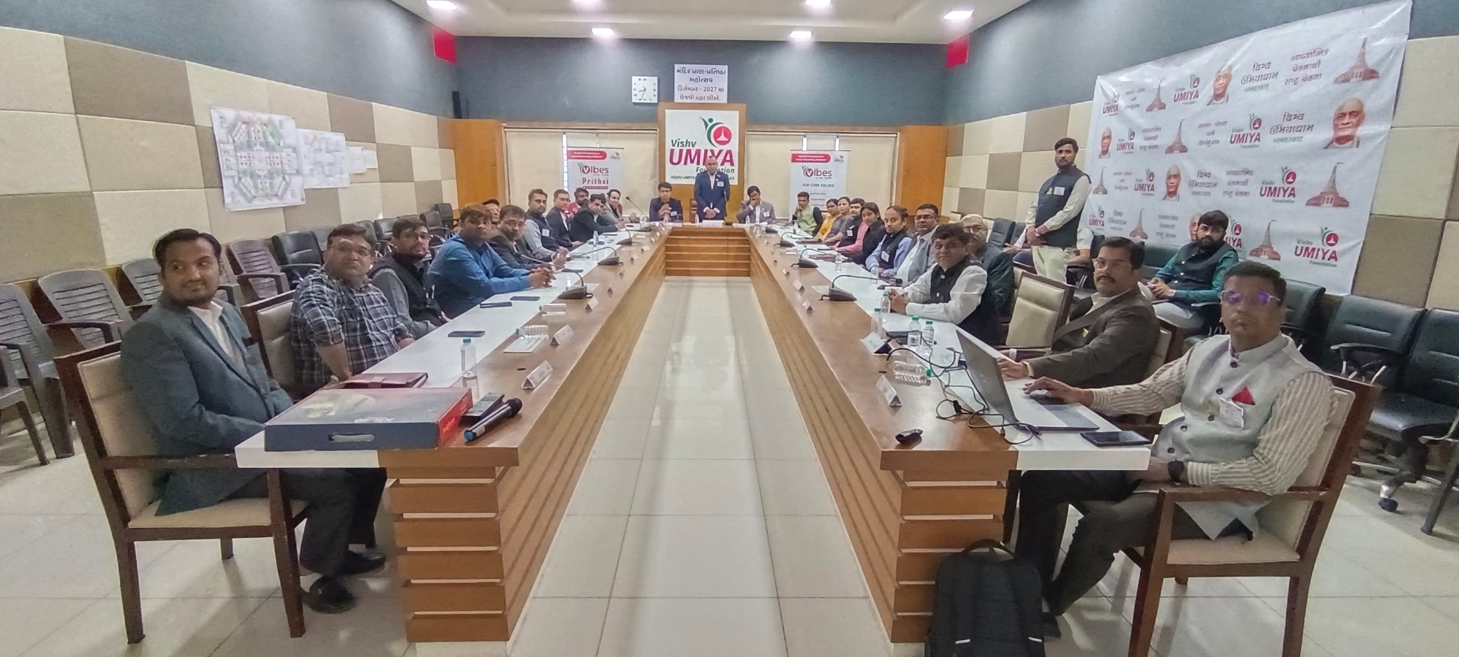
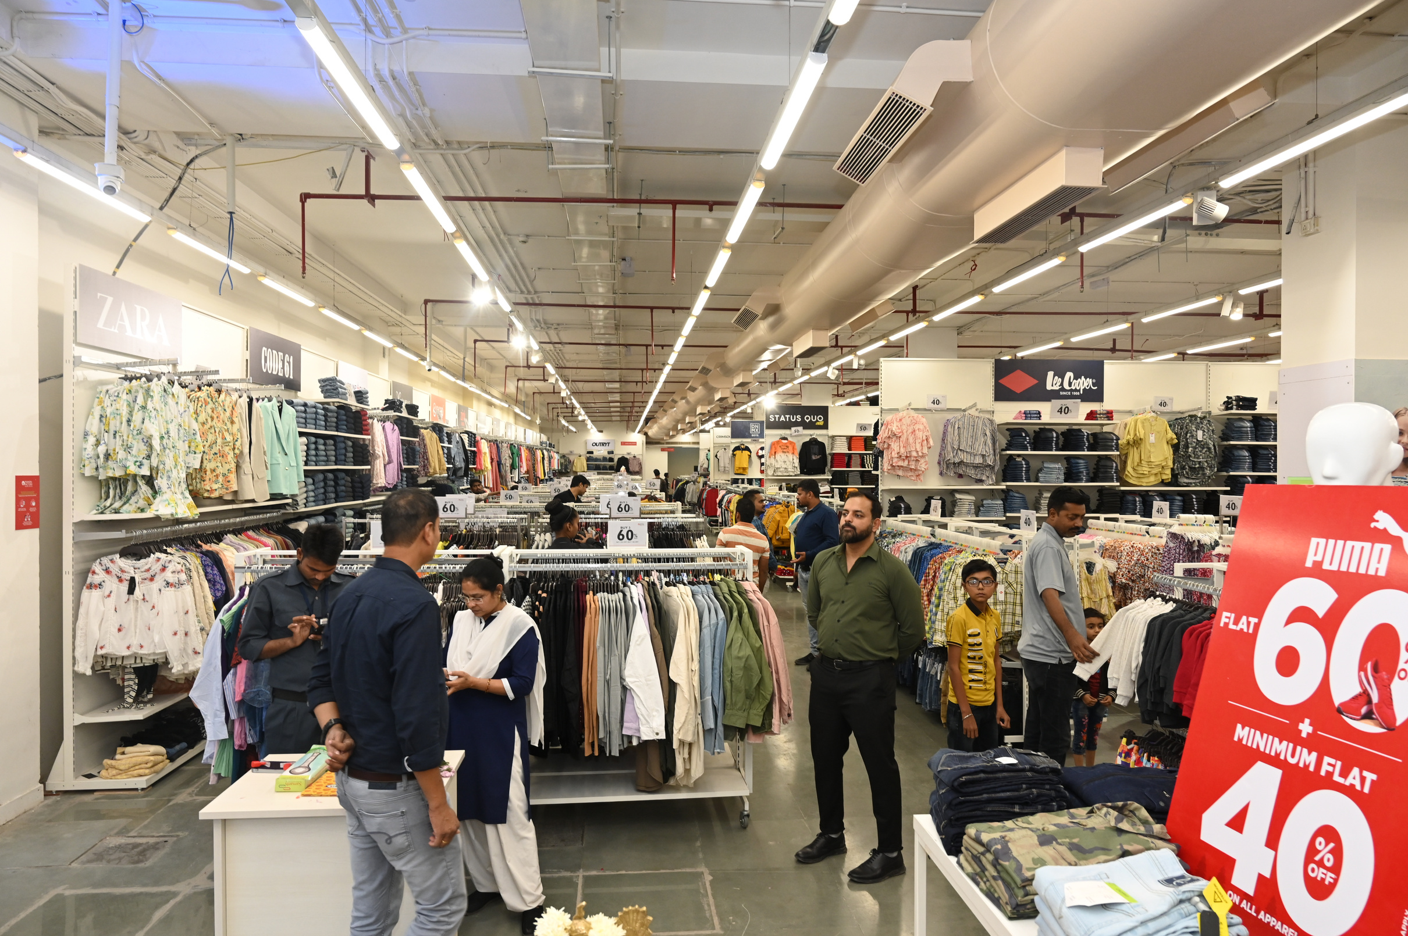
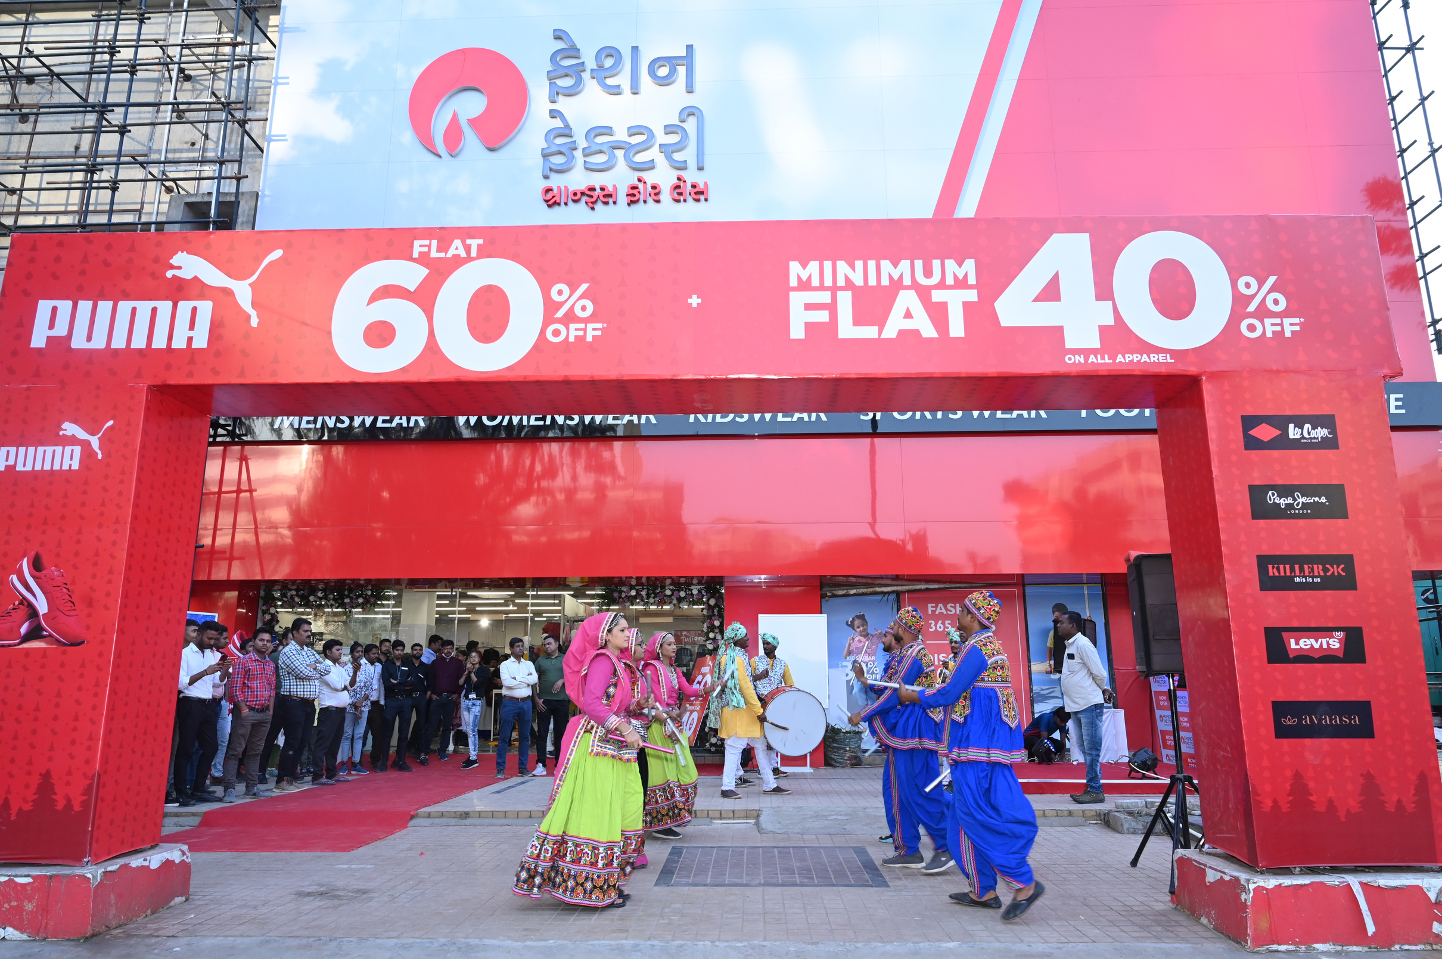

Slide 18


Slide 19


Thank You
Contact
Us
Naam HD Kaam HD
+91 95122 95773 – 9979157525.
hdstudioprofessional@gmail.com
www.hdstudio.co.in

